Slide 1
CHTC Philosophy of High Throughput Computing
Greg Thain

Slide 2
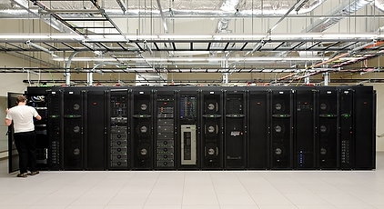
CHTC?

Slide 3
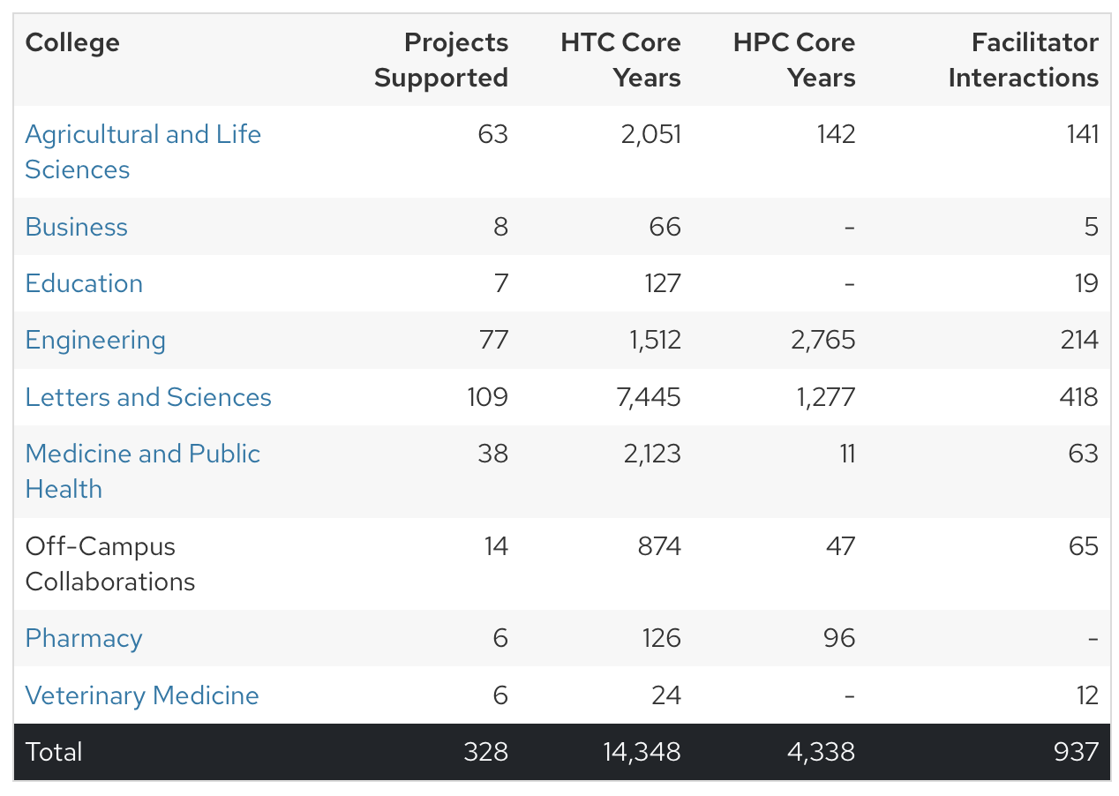

Slide 4
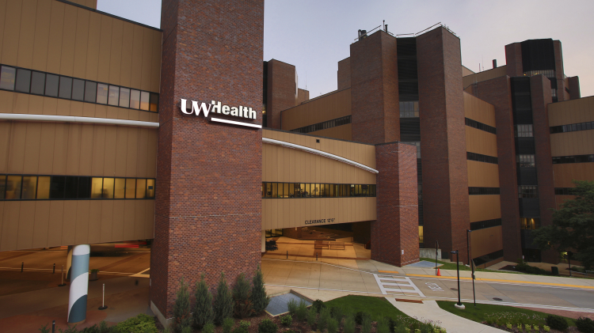

Slide 5
Our Research Laboratory

Slide 6
Research Computing ?

Slide 7
( Research ) Computing ?

Slide 8
( Research Computing ) ?

Slide 9
( (Research) Computing ) !

Slide 10

Start with People
Notes:
We start with people.

Slide 11
People have Problems
Notes:
We start with people.

Slide 12
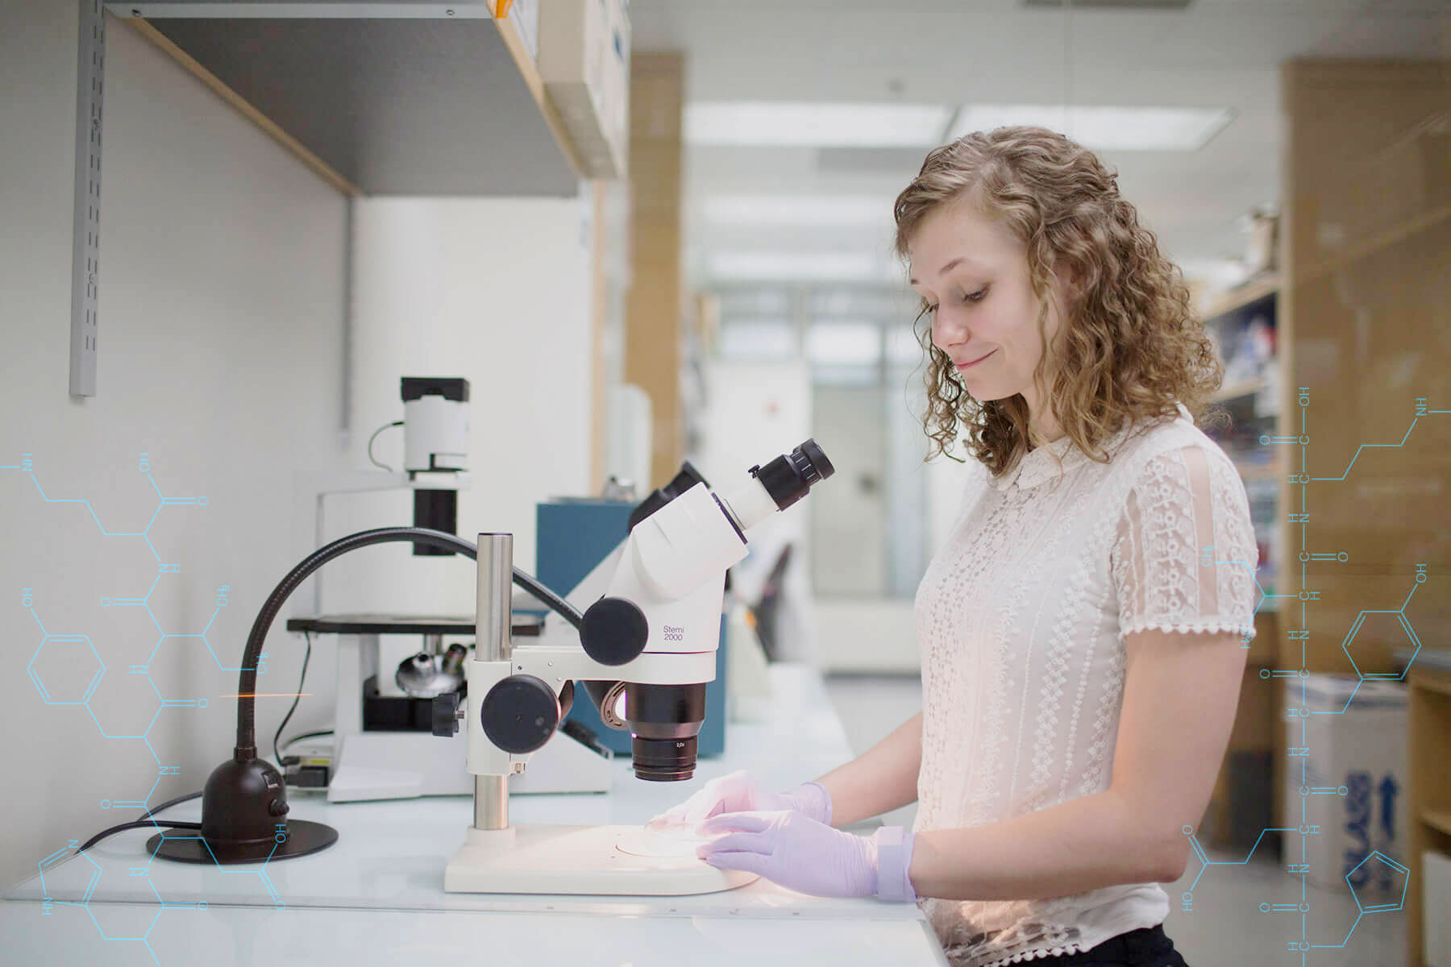
“1,000x more compute, could revolutionize
my field”
“Some of my jobs need a lot of memory, others a lot of cores”
“My laptop will take three years to complete my analysis, and I want to submit a paper in three weeks”
“I'm a Chemist,
Can't spend hours supervising runs of programs”
Notes:
This is a researcher in our Chemistry department. She has computational wants and needs. Here are three examples of problems she has with her computations.

Slide 13
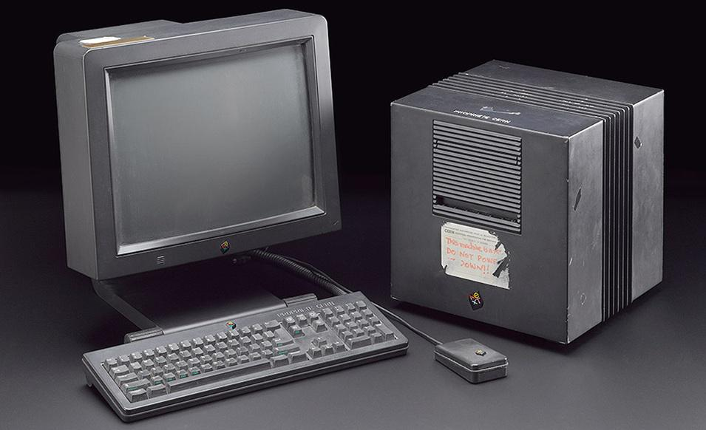

Slide 14
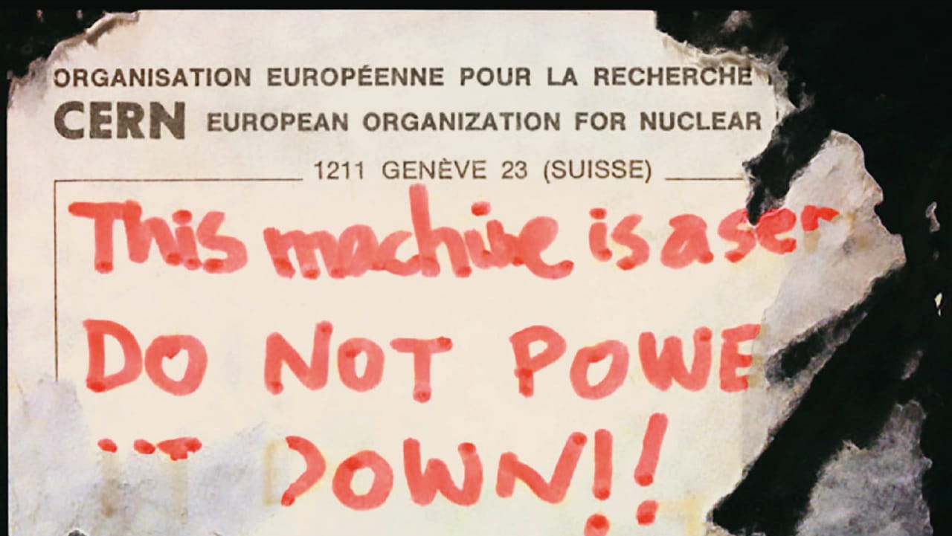

Slide 15
XKCD ?

Slide 16
XKCD 1205

Slide 17
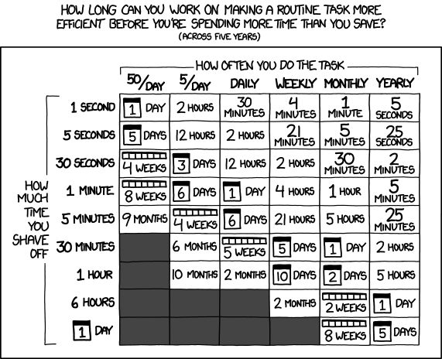

Slide 18

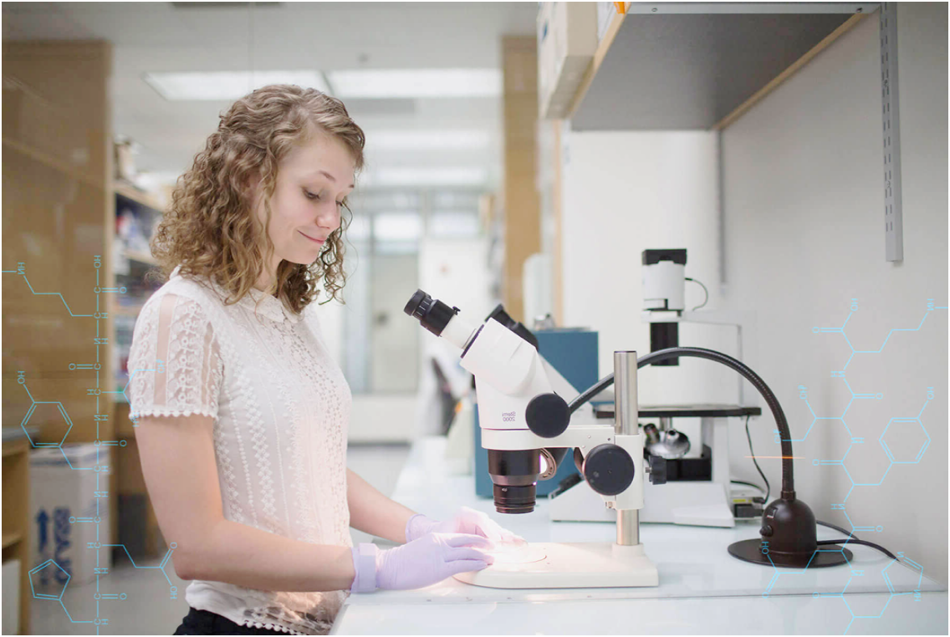
The HTCondor Access Point(AP)
Software to manage all work
All needs declared
Reliable – like money in bank
Implements user's policies
"Submit it and forget it"

Slide 19
The HTCondor Access Point(AP)
Software to manage all work
All needs declared
Reliable – like money in bank
(like money in mattress?)
Implements user's policies
"Submit it and forget it"

Slide 20
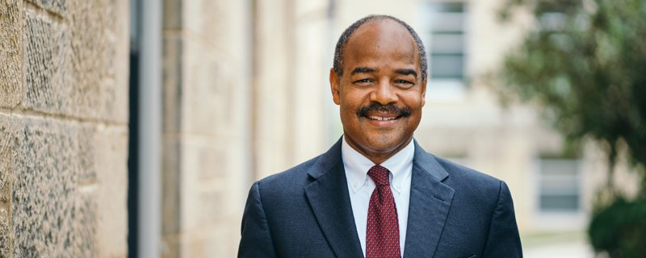
“We pay a lot of money for research computing. I want these computers always busy, helping research”
“If Physics invests twice what Chemistry does in computers, they should get 2x the computing”
“If an important group needs all the computers for three days to make a paper deadline, I’m ok with that”
Notes:
This is our dean of Letters and Sciences. He helps pay for the machines that researchers use. He also has wants and needs. Here are three of his.

Slide 21

The HTCondor Execution Point
Where work runs
Also has policy
Policy is declarative
Probably many of these

Slide 22
on many machines
Implies machines are heterogeneous
Could be machines owned by others
Could have different polices
Could be places without shared filesystem

Slide 23

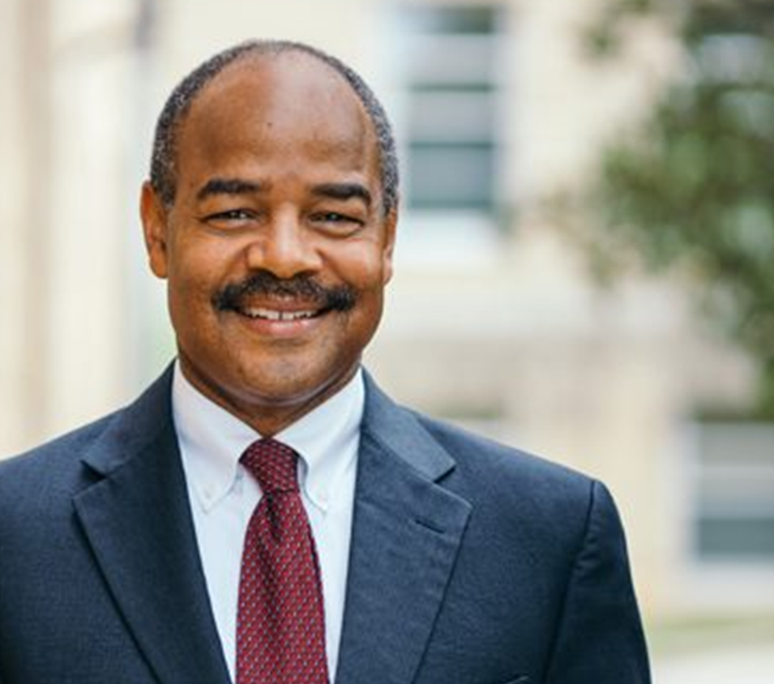
HTCondor
Manages
These
constraints
Constraints
Constraints
Notes:
HTCondor helps to manage the computing want and needs of both the user of the machine and the provider, and do that independently of one another.

Slide 24
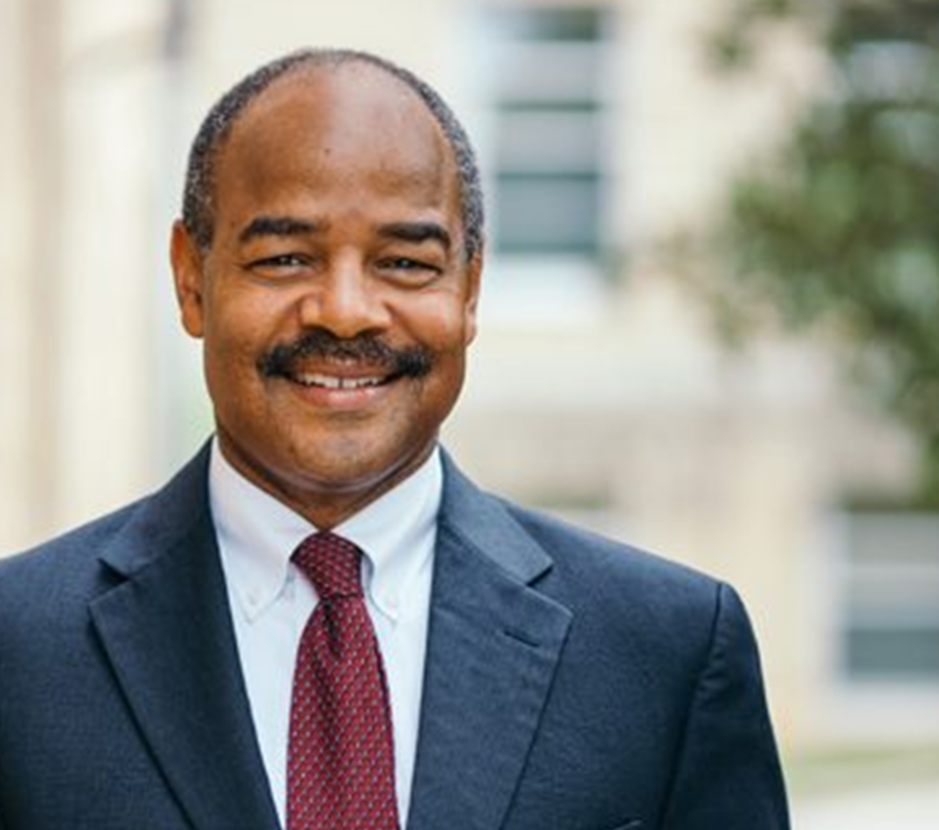
Not even that easy
In the real world, many users,
Many resource providers
Notes:
Example of GPU machines in the CHTC pool. But in the real world, it isn’t even that easy. One system is used by many people, often with conflicting needs. And any one campus doesn’t have one sole provider of resource, but many. Exampl

Slide 25
This is a distributed problem.
Distributed because of people
Not because of machines.
Our goal is to satisfy all these constraints.
Notes:
We call this kind of problem distributed. Yes, it is distributed in the sense that it uses multiple computers with a network, but more importantly, the policies are distributed – there are distributed users with different wants and needs and many providers, again with potentially conflicting wants and needs. The goal of our system is to provide mechanisms for each of these policies to be expressed independently of each other, and to harmonize the polices into one coherent system.

Slide 26
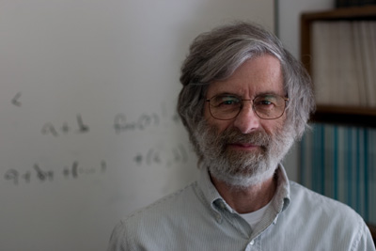
"A distributed system is one where you can't get any work done because a machine you never heard of crashes"

Slide 27

What we mean by "Distributed"
Distributed authority (people)
vs
Distributed machines – is k8s "distributed"?

Slide 28
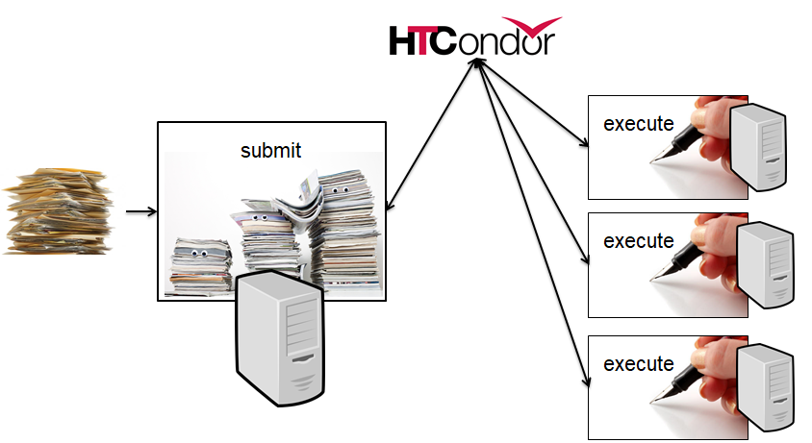
The Unstated Assumption
“All work” can be broken up into smaller jobs
Jobs (mostly) independent
Smaller the better (up to a point)
Files as ipc
Any interdependencies via DAGs
Optimize time-to-finish
not time-to-run
*
Notes:
Now, this whole philosophy is predicated on the assumption that large workflows can be broken down into many small independent jobs.

Slide 29
With the implication…
There's a LOT of jobs!
A lot of different jobs
Very different from HPC/MPI

Slide 30
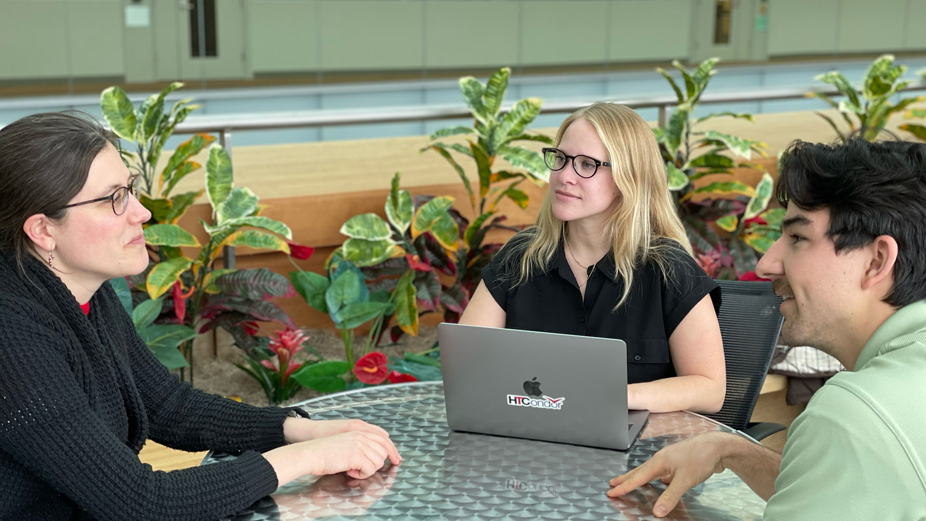

Slide 31
The Job Nature
Ideal job, with "Job Nature" is pure function
Completely described by submit file Not side effects But we don't live in a perfect world

Slide 32
Things with The Job Nature?
Genetic Search
Monte-Carlo simulation
(careful with random seeds)
Compression of large input

Slide 33
What does not have The Job Nature?
Web server
Database
Interactive notebook

Slide 34
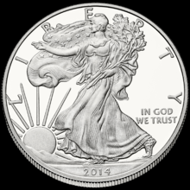

Two-faced nature of HTCondor
Split responsibility:
Worker side
AP side
We encourage different policy on both sides
(who wins in a collision?)
Always focusing on responsibility of the side
Always consider where responsibility goes

Slide 35
All while being reliable…
Reliability 1st priority
We can make HTCondor fast enough
w/o sacrificing any reliability – no screw polishing

Slide 36
Scalability: The Dream
Performance
Load
Notes:
In a perfect world, the performance of system would scale linearly with load, as you add new resources, etc. This should be true of any system, be in computing, networking or storage.

Slide 37
Scalability: Reality
Performance
Load
Notes:
Has anyone crashed an NFS service by putting too much load on it? This week? This is the usual case in many computer systems, and HTCondor strives to avoid this case where performance goes to zero because the system has crashed due to too much load.

Slide 38
Scalability: Managed
Circuit Breakers
Load Shedding
Queueing
Performance
Load
Notes:
So our performance goal, is to performance consistently at some high level without crashing. To do so, we need to add things like circuit breakers etc. This is an important part of the HTCondor philosophy. This is difficult to do in all cases, and we don’t always get it right, but we strive to manage the performance to achieve this sustained performance under increasing demand.

Slide 39

Scaling via many APs
Execute
Access Points

Slide 40
Scaling via many APs
Adding APs just helps scaling
Allows submission near the user
“Submit locally, run globally”

Slide 41
How to test this theory?
Need 2nd experimental lab
Maybe with different scale?

Slide 42
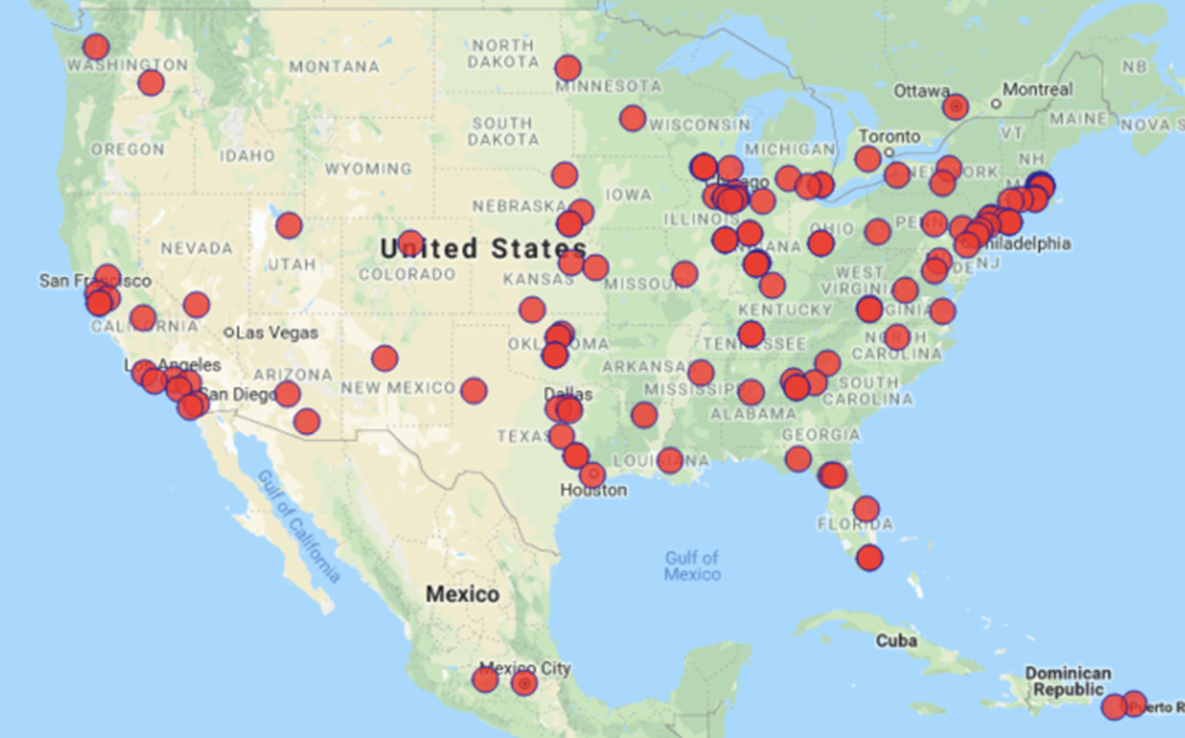

Slide 43
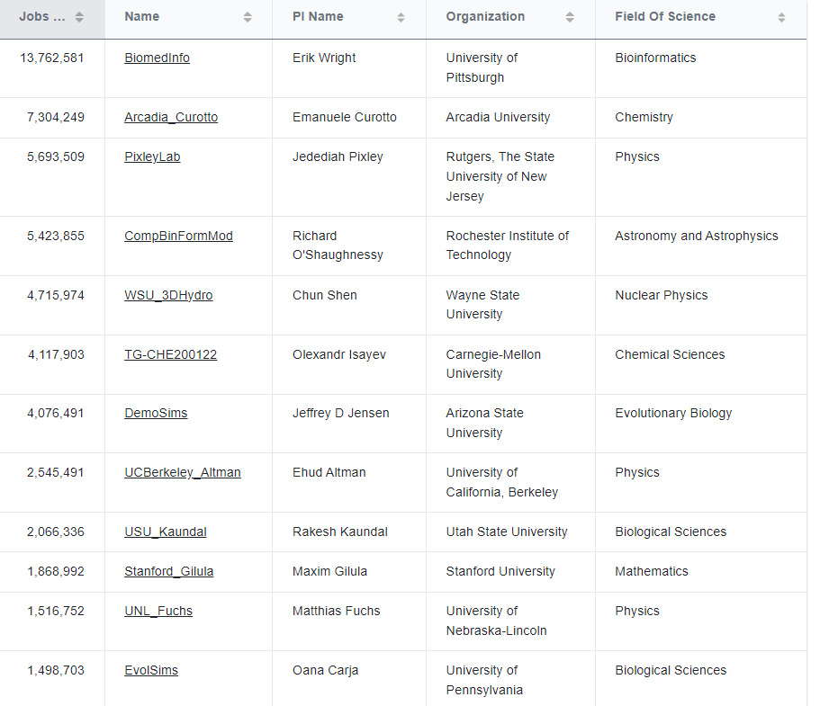

Slide 44
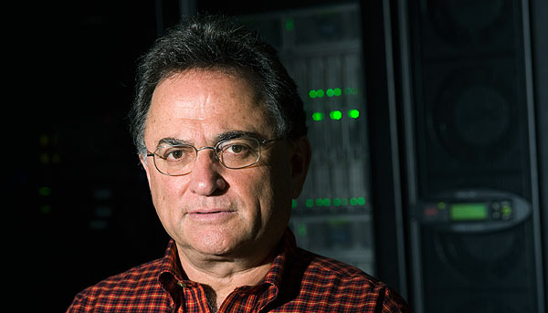
"A distributed system is one where you can get work done on a machine you never heard of." *

Slide 45
"A distributed system is one where you can get work done on a machine you never heard of." *
(even when it crashes)

Slide 46
Questions for Campus RC?
Are there CHTC/OSG users?
Batch computing small part of RC puzzle.
Is such a philosophy useful / generative?
Is there a similar theory of Campus RC?
If not, what would one look like?
What would be benefits be?

Slide 47
Start with People
Notes:
We start with people.

Slide 48
People solve Problems
Notes:
We start with people.

Slide 49
Thank you

